Slide 1
RNA sequence data and Differential Expression analysis in asthma treatment
Yanyan Deng

Slide 2
Introduction
This data shows that RNA-Seq is used to characterize the human airway smooth muscle (HASM) transcriptome at baseline and under four asthma treatment conditions.
This study tested whether the RNA sequence of asthma patients is related to the action of Dexamethasone.

Slide 3
Data
Source:https://www.kaggle.com/usharengaraju/indian-women-in-defense
Number:8x38694
Tool: R studio

Slide 4
Analysis
Hypothesis:
Ho: The RNA seq of asthma patients are related to the targeting of dexamethasone.(Dex)
H1: The RNA gene fragments of asthma patients have nothing to do with the targeting of dexamethasone
Method:
Differential gene expression analysis
T test
Linear model
Gene set enrichment analysis (GSEA)

Slide 5
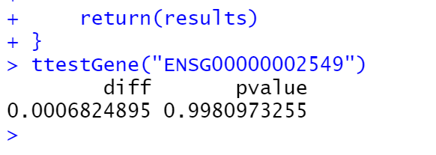
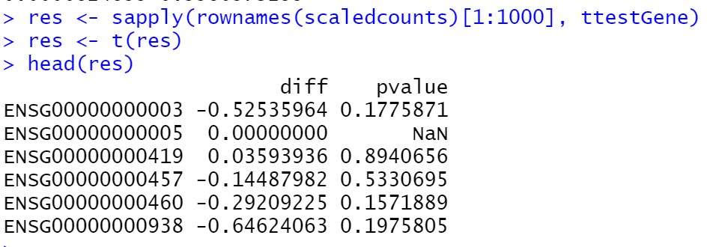
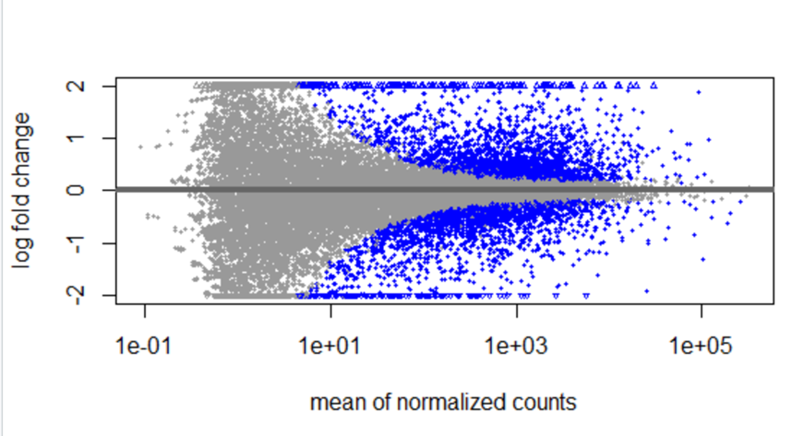
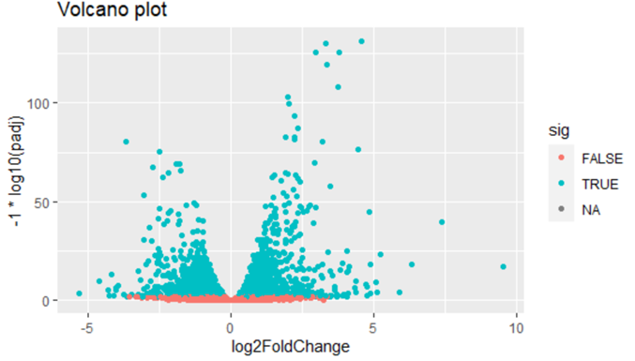
Results

Slide 6
Conclusion
Through the T test of a single gene, the difference in mean is very small relative to the variance, hence the large p-value.
With control experiments and filtering non-significant cells, it is found that the significant cells are low
There is no significant relationship between it and dexamethasone
Gene set enrichment analysis (GSEA) is a method to identify classes of genes that are over-represented in a large set of genes. After database comparison, there are no similar genes

